Slide 1
Teacher’s Revision
Topics to Study
Digital Business Strategies and Operations

Slide 2
Type of Exams (Written + Lab) – 2 Hours and 10 minutes
Part I – MCQ (20 Questions) – 20 Marks (Written)
Part II – Short-Answer Questions (5 Questions) – 30 Marks
Each Question is worth 6 Marks (Written)
Part III – Practical/Laboratory – (Manus AI and/or Base44) prompt it with a workflow and build the system prototype (50 Marks)
Task 1 – Writing
Task 2 – Writing
Task 3 – Manus AI/Base 44
Task 4 - Writing

Slide 3
LU1
Difference between E-commerce and Digital Business (Focus, Value Creation, Scope). Provide real-world examples in terms of difference
Understand the concept of Digital Value Network (Digital Transformation)

Slide 4
LU2
The concepts of Digital Strategic Tools (E.g., PESTLE, SWOT, Porter’s Five Forces Model)
Explain the concept of Digital Value Chain (BMC) – Tech-Driven
Understand how Blue Ocean is used to come up with Digital Transformations for a business (Eliminate, Raise, Reduce, Create) – Looking at Traditional/Legacy towards Digitalized Workflows/Syste,s

Slide 5
LU3
Give examples of a multi-sided platform Architecture (Healthcare, SCM, Manufacturing, Buying-Selling, Education, Hotel)
Understand the components of Digital Transformation Strategies (Cloud Computing, ERP, AI Workflows, IoT)
Differentiation between a Digital Native and Legacy System (Traditional)

Slide 6
LU4
Understand the Agile and lean operations (Healthcare, SCM/Logistics, Education, Hotel, Typical buying-selling) – Identification of Digital Waste, Kaizen (Continuous improvement)
What is RPA? How RPA works? – Logistics/SCM
What makes the customer experience better? How to improve customer experience in the context of Technology? – Synergy (Omnichannel vs. Multichannel)
OTIF (On-Time In Full) – Core Operational KPIs should be reflected in the Digital E-Business Model through Dashboards

Slide 7
LU5
How cloud computing, IoT, AI and Blockchain is used/integrated in the process/workflow to streamline and correct gaps?
Why integrate these technologies? – the purpose is for cost/time effectiveness
The software/system/digital solutions should integrate different operations of the organization and be able to provide data that can be used in decision making.
Elements/Components of Roger’s Innovation Framework (Innovators, Early Adopters, Early Majority, Late Majority, Laggards)
Understand the concepts of security in software/system/digital solutions and zero trust

Slide 8
Sample MCQ Questions
Which statement best distinguishes digital business from traditional e-commerce?
Digital business only focuses on online payment processing.
Digital business focuses exclusively on digital marketing.
Digital business integrates technology across operations, supply chains, partners and customer touchpoints.
Digital business is simply a website with an online shopping cart.
Notes:
C
Digital business involves end-to-end transformation across operations, supply chains, partners and customer touchpoints, rather than simply selling online.

Slide 9
Sample MCQ Questions
Which sequence best represents the evolution of digital strategy? A. AI → Web Presence → E-Commerce
B. Web Presence → E-Commerce → Digital Business
C. E-Commerce → Web Presence → Digital Business
D. Web Presence → Digital Business → E-Commerce
Notes:
B
The progression presented is Web Presence → E-Commerce → Digital Business.

Slide 10
Sample MCQ Questions
In a digital value network, customers are more likely to be viewed as:
Passive recipients
End points in a supply chain
Co-creators and ecosystem participants
Suppliers of physical inventory only
Notes:
C
In a digital value network, customers can become active co-creators, data sources and ecosystem participants.

Slide 11
Sample MCQ Questions
Which of the following is primarily a customer driver for digital transformation?
Cloud computing
Artificial intelligence
Demand for personalised and omnichannel experiences
Legacy hardware replacement
Notes:
C
LU1 identifies demand for personalised experiences, omnichannel access, instant fulfilment and transparent interactions as customer drivers.

Slide 12
Sample MCQ Questions
A Digital SWOT analysis places greater emphasis on which of the following?
Physical buildings and machinery only
Data assets and API ecosystems
Employee uniforms
Traditional distribution channels only
Notes:
B
Digital SWOT gives greater attention to data assets, API ecosystems and technological change.

Slide 13
Sample MCQ Questions
Customer journey mapping is primarily used to identify:
Employee salaries
Customer steps, pain points and digital touchpoints
Competitor financial statements
Network security protocols only
Notes:
B
Customer journey mapping identifies customer steps, emotions, pain points and moments of truth.

Slide 14
Sample MCQ Questions
Which KPI is particularly relevant to order fulfilment performance? A. OTIF (On-Time In-Full)
B. Number of employees
C. Office size
D. Number of company websites
Notes:
A
OTIF (On-Time In-Full) is an operational fulfilment KPI used in digital dashboards.

Slide 15
Sample MCQ Questions
Which technology captures real-time telemetry from physical assets?
Blockchain
IoT
SaaS
CRM
Notes:
B
IoT captures real-time telemetry from physical assets, supply chains and operating environments.

Slide 16
Sample MCQ Questions
Which combination best represents the logistics architecture?
IoT → Cloud → AI
Blockchain → Website → Email
CRM → Spreadsheet → Printer
Website → Social Media → Payment Gateway
Notes:
A
LU5 provides the example of combining IoT sensor data, Cloud storage and AI prediction for logistics optimisation.

Slide 17
Sample MCQ Questions
According to Rogers' Diffusion of Innovation framework, which group generally requires proven ROI and case studies?
Innovators
Early Adopters
Early Majority
Laggards
Notes:
C
The Early Majority are pragmatic adopters who generally require proven ROI and case studies before adoption.

Slide 18
Sample MCQ Questions
Which principle is central to Zero Trust?
Trust all internal users
Trust users once they enter the network
Never Trust, Always Verify
Give all users administrator access
Notes:
C
Zero Trust uses the principle "Never Trust, Always Verify."

Slide 19
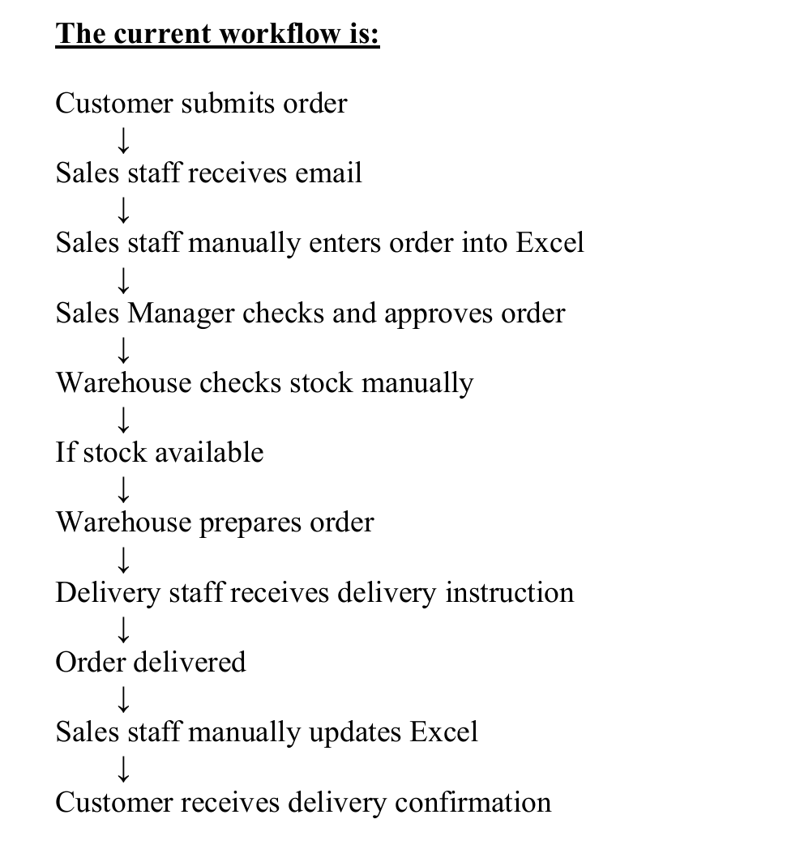
Generate a Manus AI/Base44 Application to streamline the workflow below
What are the digital waste to eliminate?
1. Manual Data Entry (Overprocessing)
2. Defects (Error in data entry, system bugs, operational glitches)
3. Waiting Time

